Slide 1
Practical Kinetics
Practice 1:
Kinetic Resolution
Objectives:
Timecourse simulation of first-order kinetic resolution
Predict yield as a function of selectivity factor

Slide 2
Practice Assignment 1
This exercise reviews the material in Exercise 0.
You should be familar with:
import statements
list comprehensions
mathematical operations (in particular, math.exp)
plotting
Consider a first-order kinetic resolution:
Suppose that k_{R} = 1.0 and k_{S} = 0.1. For a racemate, compute the timecourse of this reaction from 0 to 100 seconds. Calculate the starting material and product ee as a function of conversion. Assume the total starting concentration is 1.0.

Slide 3
Practice Assignment 1
In the next slides, I will give some fill-in-the-blank code. Try not to look at the answers until you’ve given it a good try.
Strategy:
Make four lists, SM_R, PDT_R, SM_S, and PDT_S to hold the concentrations as a function of another list called time. Calculate the concentrations using the first-order integrated rate law.
Then generate three more lists, conversion, ee_SM, and ee_PDT. For each point in time, look at the starting material and product concentrations to calculate these quantities (using list comprehensions).
Instead of plotting concentration vs. time, we’ll plot starting material ee vs. conversion.

Slide 4
Code Outline 1
import matplotlib
import matplotlib.pyplot as plt
import numpy as np
from math import exp
%matplotlib inline
# rate constants
k_R = ___
k_S = 0.1
# starting concentrations
SM_R_0 = ___
SM_S_0 = ___
total_concentration = ___ + ___
# this fills the interval [1E-3, 1E2] with 50 points logarithmically
# this helps even out the points on the graphs we will make
time = np.logspace(-3,2,50)
# use the range command to get the indices of time: [0, 1, ..., len(time-1)]
indices = ___
# use exp(-k*t) in a list comprehension
SM_R = [ ___ ]
PDT_R = [ ___ ]
SM_S = [ ___ ]
PDT_S = [ ___ ]

Slide 5
Code Outline 1
(continued)
conversion = [ ___ for i in indices ]
ee_SM = [ ___ for i in indices ]
ee_PDT = [ ___ for i in indices ]
# plot
plt.plot(___, ___, "r.", label="ee (SM)")
plt.plot(___, ___, "b.", label="ee (PDT)")
plt.xlabel("conversion")
plt.ylabel("enantiomeric excess")
# this puts the legend in the best place
plt.legend(loc="best")

Slide 6
Solutions to Assignment 1
Here is my answer:
import matplotlib
import matplotlib.pyplot as plt
%matplotlib inline
import numpy as np
from math import exp
# rate constants
k_R = 1.0
k_S = 0.1
# starting concentrations
SM_R_0 = 0.5
SM_S_0 = 0.5
total_concentration = SM_R_0 + SM_S_0
# simulate
time = np.logspace(-3,2,50)
indices = range(len(time))
SM_R = [ SM_R_0 * exp(-k_R*t) for t in time ]
PDT_R = [ SM_R_0 - i for i in SM_R ]
SM_S = [ SM_S_0 * exp(-k_S*t) for t in time ]
PDT_S = [ SM_S_0 - i for i in SM_S ]

Slide 7
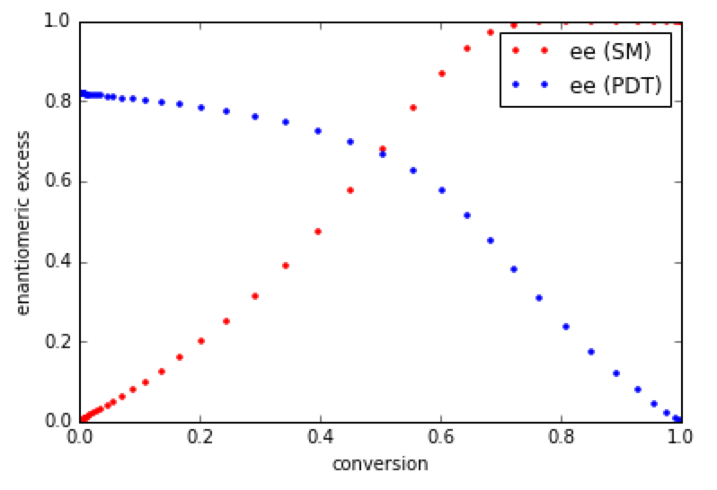
Solutions to Assignment 1
(continued)
conversion = [ (PDT_R[i] + PDT_S[i]) / total_concentration for i in indices ]
ee_SM = [ (SM_S[i] - SM_R[i]) / (SM_R[i] + SM_S[i]) for i in indices ]
ee_PDT = [ (PDT_R[i] - PDT_S[i]) / (PDT_R[i] + PDT_S[i]) for i in indices ]
# plot
plt.plot(conversion, ee_SM, "r.", label="ee (SM)")
plt.plot(conversion, ee_PDT, "b.", label="ee (PDT)")
plt.xlabel("conversion")
plt.ylabel("enantiomeric excess")
plt.legend(loc="best")
For this relatively low s factor of
10.0, the reaction must be run
to at least 70% conversion to
get high ee in the recovered
starting material.

Slide 8
Practice Assignment 2
Plot the yield of recovered starting material, given a target ee and selectivity factor.
Strategy:
Run a series of timecourse simulations, with different selectivity factors. To do this, hold k_{S} fixed and adjust k_{S} to give the desired selectivity factor.
For each selectivity factor, find the conversion at which the starting material ee is at the desired level.
Because the timecourse simulation has a finite number of points, the starting material may never reach the desired ee exactly. However, we will have a series of points (starting material ee, conversion).
If we interpolate these points, we can generate a function to give us the information we need: (target starting material ee, conversion at the target ee).

Slide 9
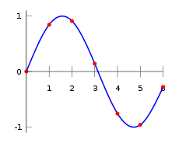
Practice Assignment 2
Plot the yield of recovered starting material, given a target ee and selectivity factor.
You will need the interp1d function from scipy.interpolate. It takes a series of points (x₁, y₁), (x₂, y₂), ..., (x_{n}, y_{n}) and creates a smooth function between them:
One can then evaluate the function at an arbitrary point x, as long as x remains in the interpolation domain. The code outline on the next page shows you how to do it in this context. (Technical Note: we’ll use a cubic spline, the most popular algorithm.)

Slide 10
Code Outline 2
Fill in the blanks below. (This assumes the previous code is present.)
from scipy.interpolate import interp1d
# gives the yield of the recovered starting material given a target
# ee and selectivity factor
def SM_yield(target_ee, selectivity):
# assume k_S is constant
k_R = k_S * ___
# recalculate with new rate constants (look at previous code)
SM_R = [ ___ ]
PDT_R = [ ___ ]
SM_S = [ ___ ]
PDT_S = [ ___ ]
conversion = [ ___ ]
ee_SM = [ ___ ]
# if the ee never gets up to the target ee in this simulation,
# return a starting material yield of zero
#
# this occurs for low selectivity factors
if max(ee_SM) < target_ee:
return 0.0

Slide 11
Code Outline 2
(the function, continued)
def SM_yield(target_ee, selectivity):
...
# interpolate the conversion vs. ee function
interpolation_function = interp1d(ee_SM, conversion)
interpolated_conversion = interpolation_function(target_ee)
# calculate the starting material yield
this_yield = ___ - ___
return this_yield
Now, let’s run the simulation and plot:
target_ee = 0.99
selectivities = np.logspace(0.1, 2, 50)
yields = [ SM_yield(___,___) for ___ ]
plt.plot(___, ___, "r.", label="99% ee")
plt.legend(loc="best")
plt.xlabel("s factor")
plt.ylabel("yield")

Slide 12
Solutions to Asssignment 2
from scipy.interpolate import interp1d
def SM_yield(target_ee, selectivity):
k_R = k_S * selectivity
SM_R = [ SM_R_0 * exp(-k_R*t) for t in time ]
PDT_R = [ SM_R_0 - i for i in SM_R ]
SM_S = [ SM_S_0 * exp(-k_S*t) for t in time ]
PDT_S = [ SM_S_0 - i for i in SM_S ]
conversion = [ (PDT_R[i] + PDT_S[i]) / total_concentration for i in indices ]
ee_SM = [ (SM_S[i] - SM_R[i]) / (SM_R[i] + SM_S[i]) for i in indices ]
if max(ee_SM) < target_ee:
return 0.0
interpolation_function = interp1d(ee_SM, conversion)
interpolated_conversion = interpolation_function(target_ee)
this_yield = 1.0 - interpolated_conversion
return this_yield
target_ee = 0.99
selectivities = np.logspace(0.1, 2, 50)
yields = [ SM_yield(target_ee, i) for i in selectivities ]
plt.plot(selectivities, yields_90, "r.", label="99% ee")
plt.legend(loc="best")
plt.xlabel("s factor")
plt.ylabel("yield")

Slide 13
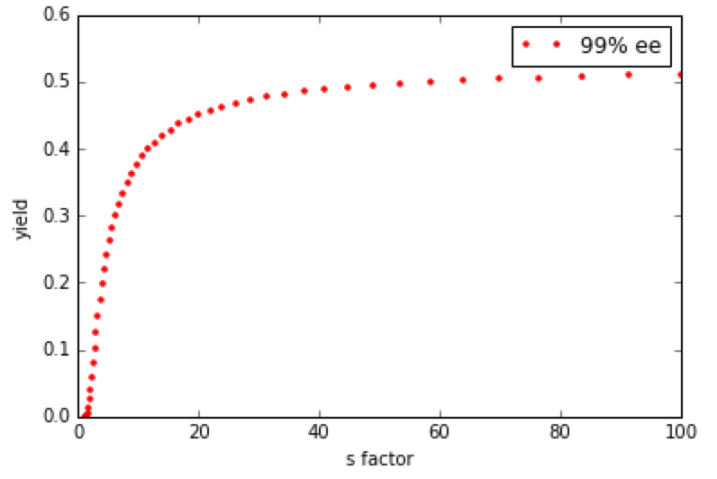
Solutions to Asssignment 2
Once the selectivity factor passes 30 or so, the yield in 99% ee starting material is essentially quantitative.
Try plotting some other selectivity factors!

Slide 14
Summary
In these practice problems, we:
imported libraries
calculated concentrations with list comprehensions
computed quantities like conversion and ee from (time, concentration) data
made some plots
We also learned how to:
use np.logspace to populate lists logarithmically
(as opposed to linearly, as with np.arange or np.linspace)
generate interpolations with scipy.interpolate.interp1d
We will use these commands in Exercise 2 to process some kinetic data.

